Slide 1
Spinal Cord Injury
Mischievous, Killer, Catapulting

Slide 2
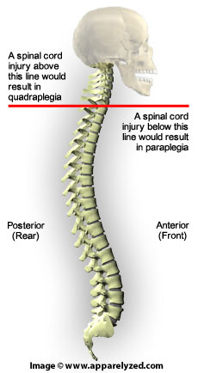
Quadriplegia VS Tetraplegia
Latin -Quadra (four)
Greek -Plegic (paralysis)
-Tetra (four)
-Para (two)

Slide 3
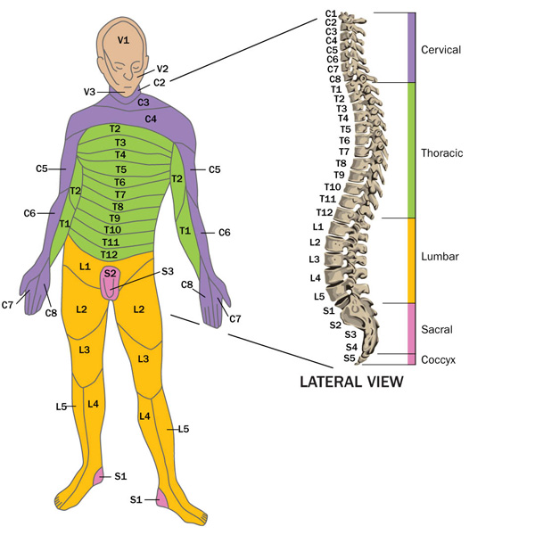
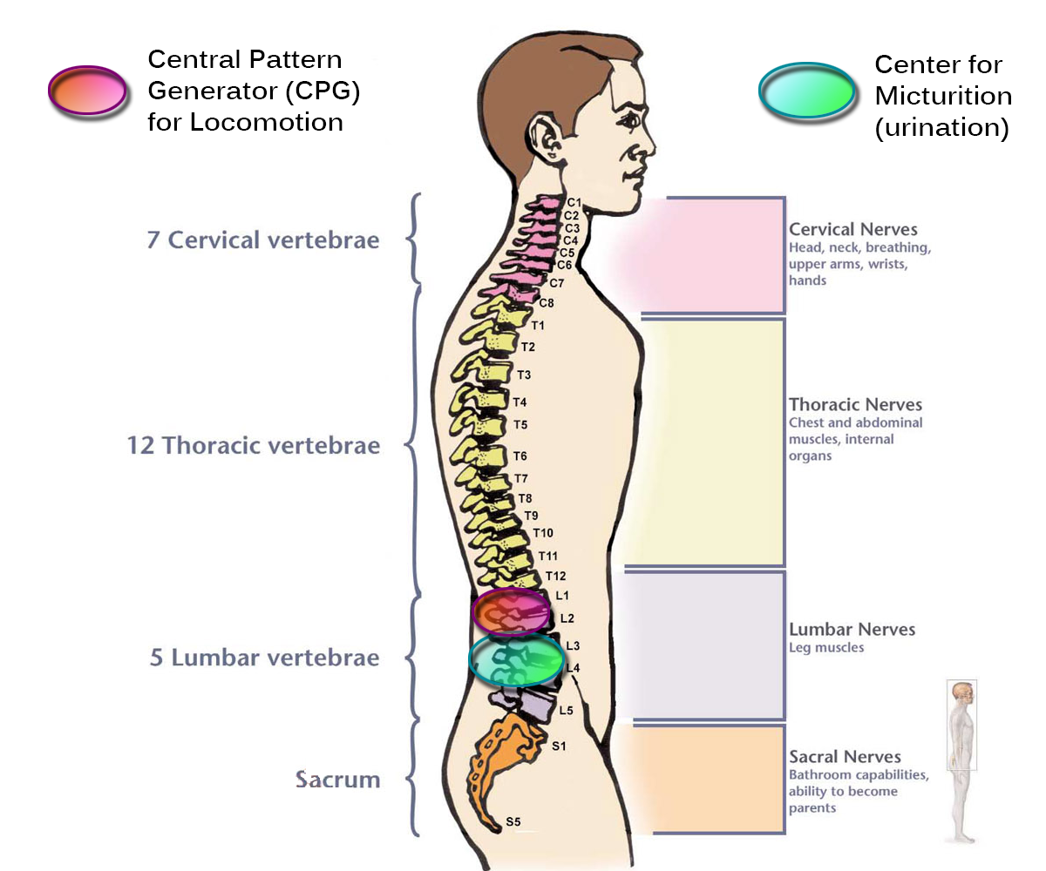

Slide 4
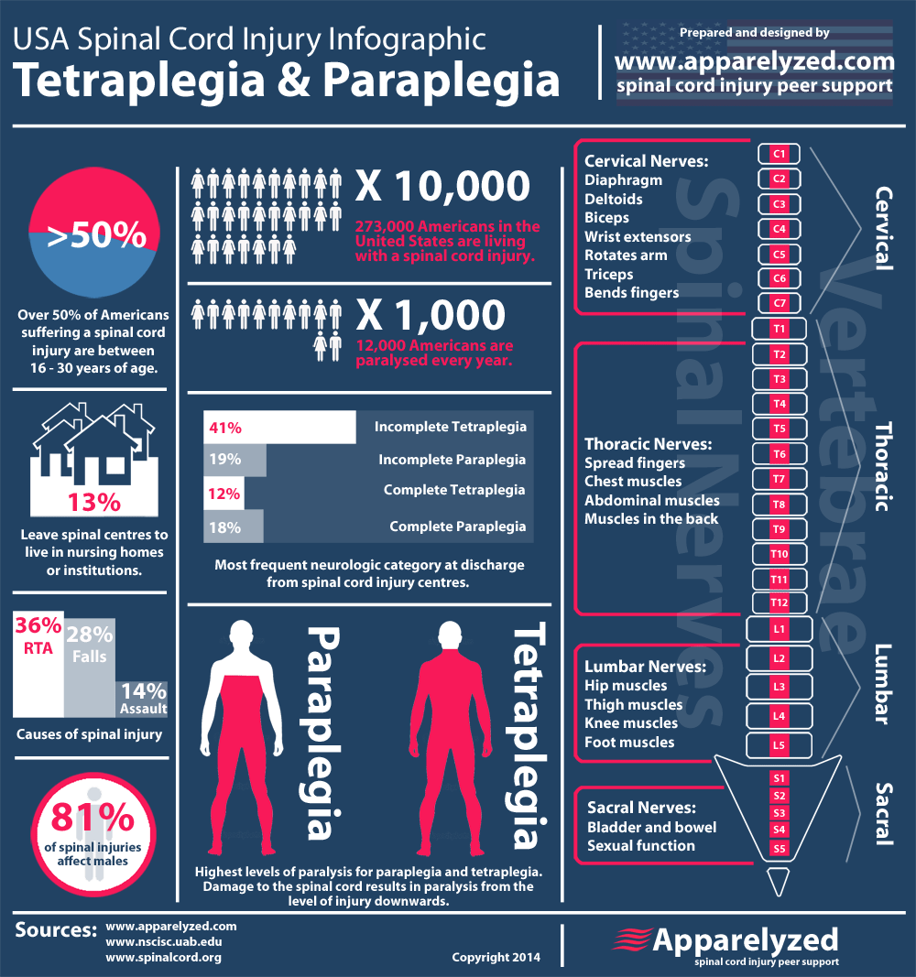
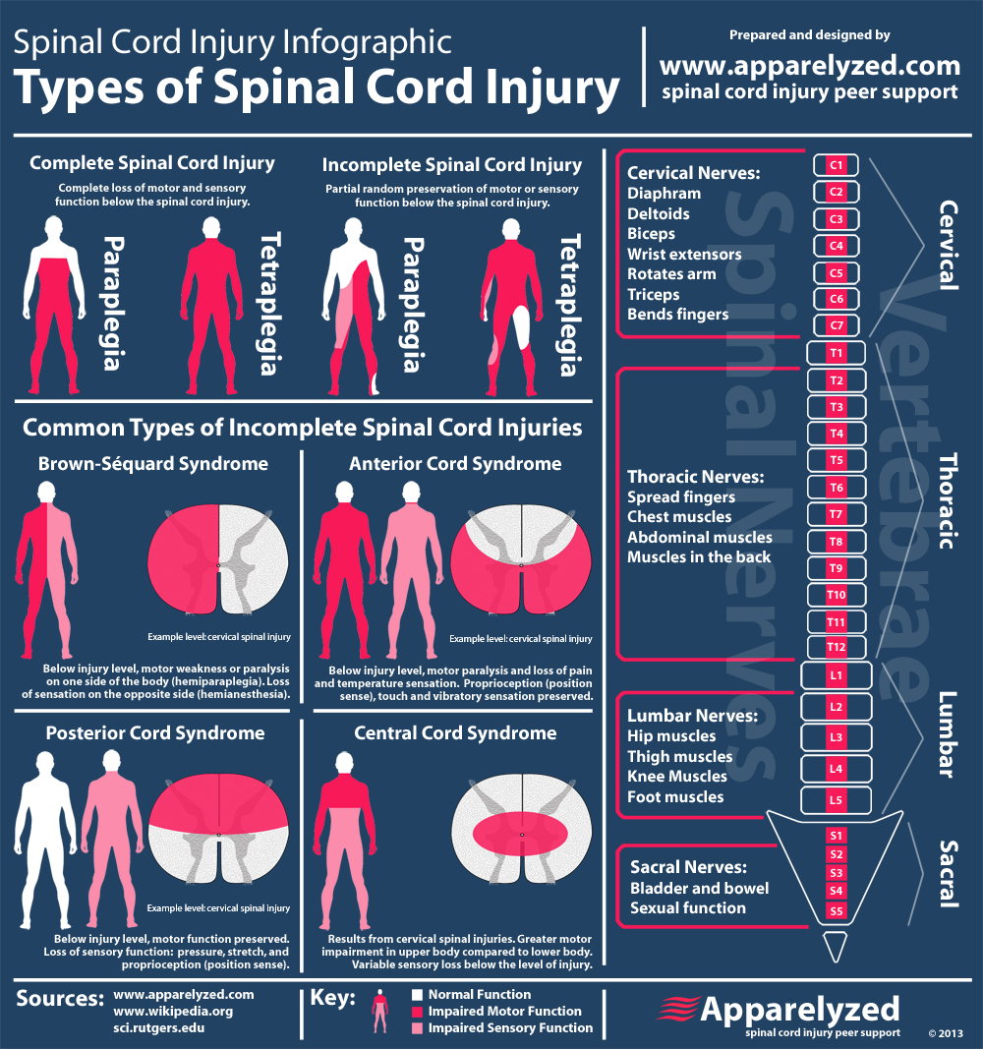

Slide 5
Diagnosis
CT scan
MRI scan
Myelogram
SSEP (somatosensory evoked potential)
x-rays
A few days later. . .
neurological test

Slide 6
Symptoms
Due to nerve damage
loss of sensation
extreme pain
inability to control bowel and bladder
Difficulty breathing
Difficulty with balance & walking
Prognosis--irreversible

Slide 7
Medications
Treat symptoms
fever
pain
fatigue
drowsiness
Presents other symptoms

Slide 8
Medications
Umbilical cord blood - stem cells
5 days
Motor function

Slide 9
Therapeutic Recreation Activities
Community Involvement
Volunteer
Leisure Skills
Adaptive swimming
What do they like?
Outdoor participation
Adaptive skiing
Snowmobiling

Slide 10
Therapeutic Recreation Implications
Study
Positive predictor of 1 year mark
Community Activity
Leisure Skill
Productive & Healthy life
Further Research: long-term outcomes

