Slide 1
What is the #1 reason that students drop out of school?
Depression
Notes:
Healthline.com

Slide 2
Depression
By: Motorcycle and Happenin

Slide 3
Definition
Depression is a mood disorder that causes a persistent feeling of sadness and loss of interest. Also called major depression, major depressive disorder or clinical depression, it affects how you feel, think and behave and can lead to a variety of emotional and physical problems. You may have trouble doing normal day-to-day activities, and depression may make you feel as if life isn't worth living.
3 main types:
Major Depressive Disorder
Dysthymia
Double Depression
Notes:
http://www.mayoclinic.org/diseases-conditions/depression/basics/definition/con-20032977

Slide 4
Major Depressive Disorder
DSM-5 Characterizes MDD by major depressive episodes (that last at least 2 weeks).
A major depressive episode includes at least 5 of the following symptoms…
From the pictures, try to guess the required symptoms!!!

Slide 5
Depressed Mood (in children--irritability)

Slide 6
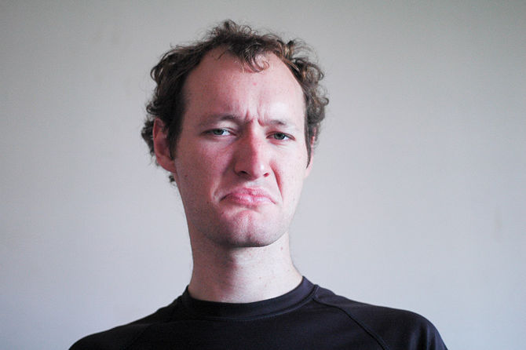
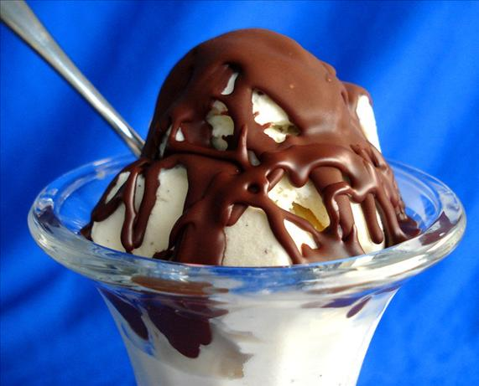
Diminished interest/pleasure

Slide 7
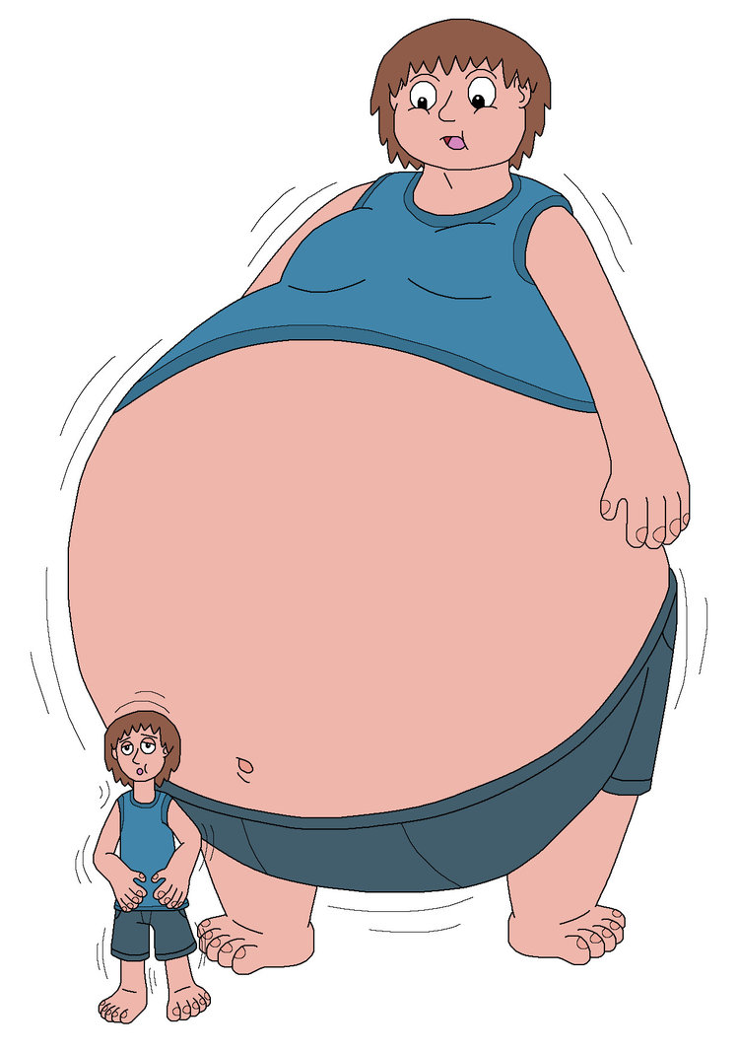
Weight loss/Weight gain

Slide 8
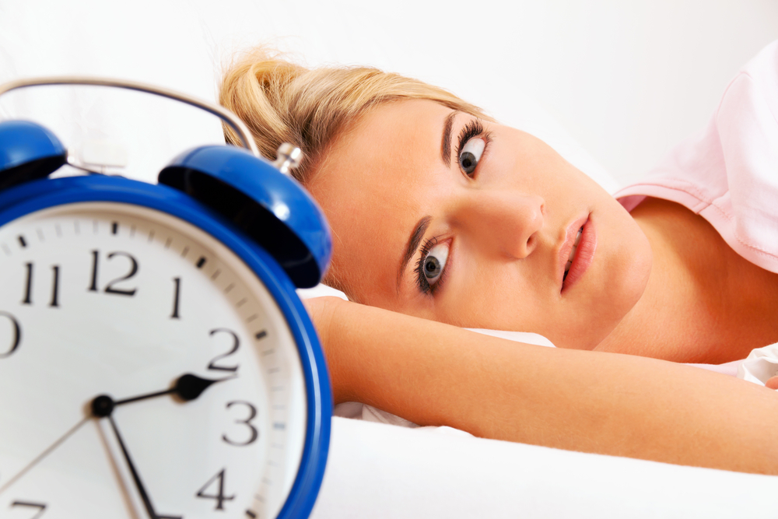
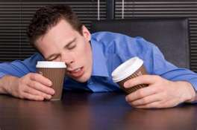
Insomnia or hypersomnia

Slide 9
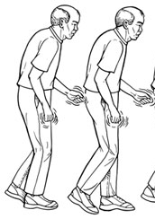
Psychomotor agitation

Slide 10
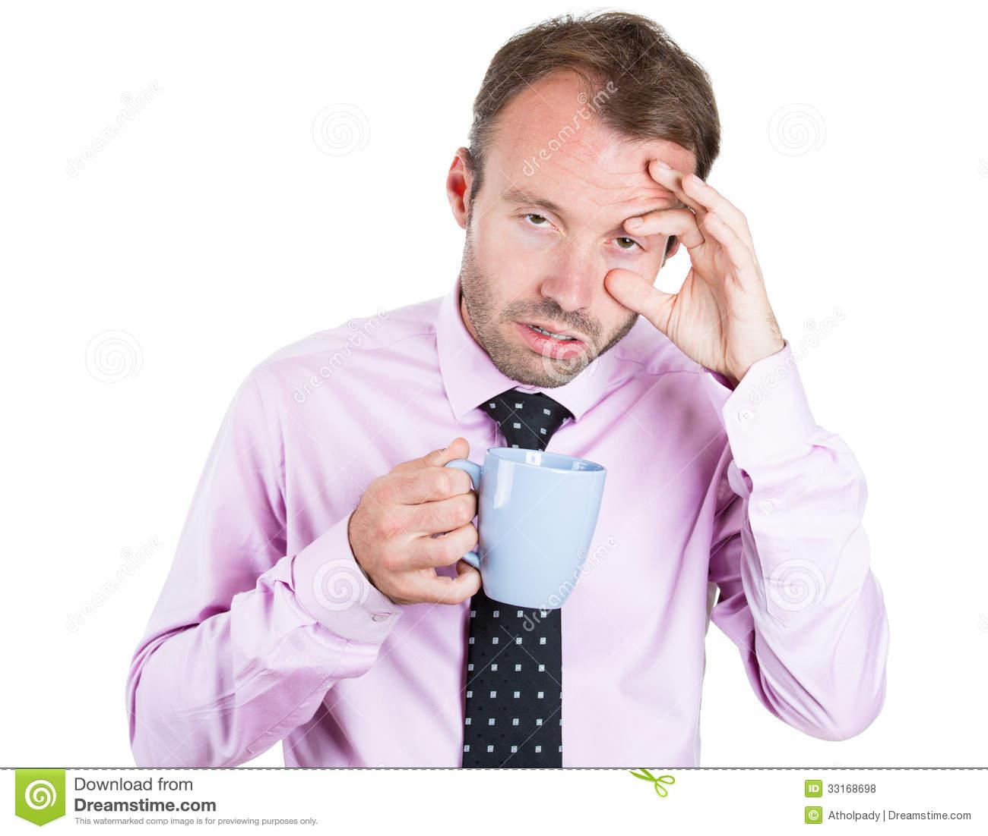
Fatigue or loss of energy

Slide 11
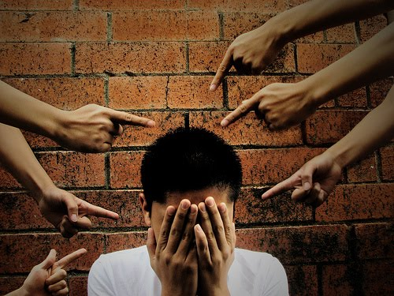
Feelings of worthlessness/guilt

Slide 12
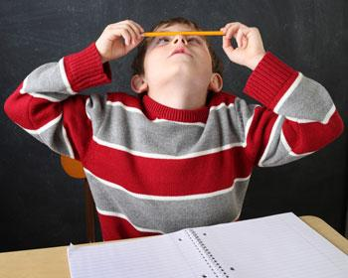
Diminished abilities to think/concentrate

Slide 13
Thoughts of death/suicide

Slide 15
Dysthymia
Largely the same as MDD
But longer in duration.
The symptoms must last for at least 2 years

Slide 16
Double Depression
If you suffer from BOTH major depressive episodes AND dysthymia, you have…
i.e. Alternating between crummy and really crummy...for a really long time

Slide 20
Quick activity
Identify one of the saddest days of your life.
For 1 minute, write down not what happened on that day, but in as much detail as you can, how you felt.
Now imagine that you felt this way all the time--or very consistently
How would that affect the way that you live your lives? Study for school? Interact with your friends? Do for fun? Eat?

Slide 21
Specific population
US!!!
i.e. College students

Slide 22
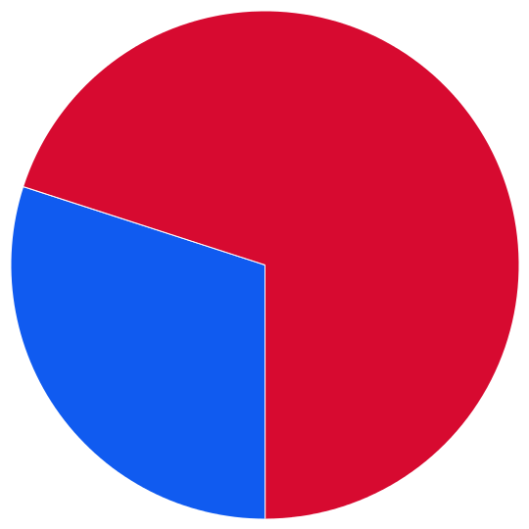
30 percent of college students reported feeling "so depressed that it was difficult to function"
Notes:
http://www.nimh.nih.gov/health/publications/depression-and-college-students/index.shtml National Institute of Mental Health

Slide 23
Depression is the number one reason students drop out of school or die by suicide.

Slide 24
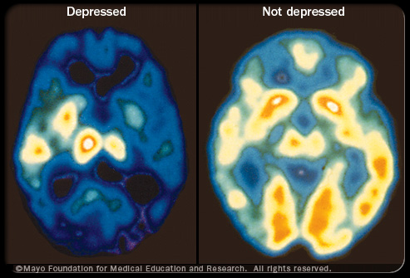
Notes:
http://www.medicinenet.com/depression/page11.htm

Slide 25
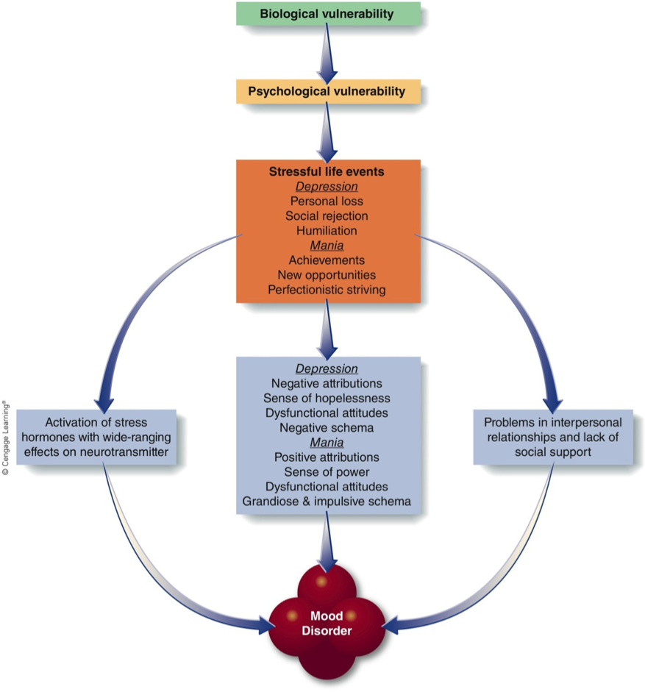

Slide 26
What causes depression in college students?
Living away from family for the first time
Missing family or friends
Feeling alone or isolated
Experiencing conflict in relationships
Facing new and sometimes difficult school work
Worrying about finances
--National Institute of Mental Health

Slide 27
Prognosis/progression
Prognosis: “most people who experience one such episode will eventually have another one”
...For this reason, the most effective long term treatments are not necessarily antidepressants or medications.
Notes:
http://www.medicinenet.com/depression/page11.htm

Slide 28
Treatment
Brain Stimulation
ECT
TMS
Vagus nerve stimulation
Medication
SSRIs
Tricyclics
MAO Inhibitors
Psychological
CBT
IPT
Notes:
MAO=Monoamine oxidase inhibitor
IPT=interpersonal therapy
ECT=electroconvolsive therapy
TMS=Transcranial Magnetic stimulation

Slide 29
Other Treatments/Specific Needs
Population specific needs--
How about for college students?
EXERCISE as an effective treatment
Eating habits

Slide 30
TR implications
Notes:
What are some ideas of how to apply TR to treating depression?

Slide 31
Life Implications
Elder Holland on Depression: http://www.youtube.com/watch?v=05FrWv01aCY

Slide 32
College Campus Resources
BYU Counseling and Career Center (CCC) offers free personal counseling for full-time BYU students.
Individual and group psychotherapy
Stress Management and Biofeedback lab at the CCC offers training in skills such as relaxation techniques
Notes:
https://caps.byu.edu/depression

Slide 36
Causes of Depression
Abuse
Certain Medications
Conflict
Death or a loss
Genetics
Major events
Other personal problems
Serious illnesses
Substance abuse
Notes:
http://www.webmd.com/depression/guide/causes-depression

