Slide 1
Cerebral Palsy
Muscular Dystrophy Multiple Sclerosis
Catapulting, Mischievous, Killer

Slide 2
Types of Cerebral Palsy
Spastic-Groups of muscles unable to relax
Non-Spastic-Muscles tighten and loosen at random or in a rhythm
Mixed-different muscle groups displaying different types

Slide 3
Cerebral Palsy
https://www.youtube.com/watch?v=Kzb1XYGO0IQ

Slide 4
Cerebral Palsy
Impairment of
muscle tone
balance
reflexes
posture
speech
swallowing and feeding

Slide 5
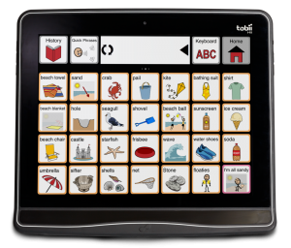
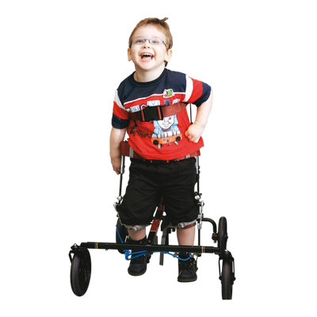
Cerebral Palsy - Equipment
Mobility devices
Adapted toys/games
Home modifications
Transportation
Communication
Self-care

Slide 6
Cerebral Palsy - TR Implications
Cerebral Palsy International Sports and Recreation Association World Championship
http://cpisra.org/dir/

Slide 7
Muscular Dystrophy
Muscular dystrophy (MD) is a group of inherited diseases in which the muscles that control movement (called voluntary muscles) progressively weaken. In some forms of this disease, the heart and other organs are also affected. (WebMD)

Slide 8
Muscular Dystrophy
9 Types (refer to packet)
Genetic

Slide 9
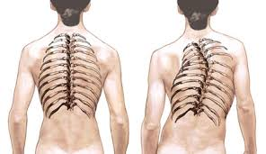
Muscular Dystrophy
atrophy, especially muscular
scoliosis
walking difficulties
frequent falling
waddling
muscle spasms

Slide 10
Muscular Dystrophy - TR Implication
Low QOL
Increased muscle movement

Slide 11
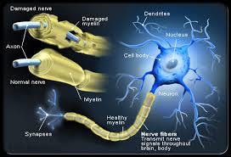
Multiple Sclerosis
What is it?
https://www.youtube.com/watch?v=qgySDmRRzxY

Slide 12
4 Types
Relapse-Remitting Multiple Sclerosis (RRMS)
90% of MS population
Usually occur in early 20’s
Periodic attacks (relapse) followed by partial or complete recovery (remission).
Eventually most enter a secondary progressive phase

Slide 13
4 Types
2. Secondary-Progressive Multiple Sclerosis
Symptoms become consistent without relapses or remissions
Usually occurs 10-20 years after RRMS diagnosis
Unclear why relapse and remission discontinue
More slow degeneration of nerves

Slide 14
4 Types
3. Progressive-Relapsing Multiple Sclerosis
Least common form of MS 5% of MS population
Relapse occur periodically, but symptoms are progressive

Slide 15
4 Types
4. Primary-Progressive Multiple Sclerosis
10-15% of MS population
Symptoms progress steadily after diagnosis
little or no remission
Average age of those diagnosed, 40 yr

Slide 16
Relapse
https://www.youtube.com/watch?v=uOy3sIrUg6Q

Slide 17
Multiple Sclerosis
impairment of walking, balance, and coordination
bladder and bowel dysfunction
dizziness and vertigo
spasticity

Slide 18
Multiple Sclerosis - Medications
Interferon (IFN)-β-1a (two formulations, Avonex and Rebif)
IFN-β-1b (Betaseron)
Glatiramer acetate (GA) (Copaxone)
Mitoxantrone (Novantrone)
Superior to Placebo, but doesn’t halt progression

Slide 19
Multiple Sclerosis - Medications
Early treatment
Pregnant
Breastfeeding

Slide 20
MS - TR Implications
Increase QOL
Lower Depression
Higher cognition and self-efficacy
Barriers
Fatigue
Lack of motivation
Cost

