Slide 1
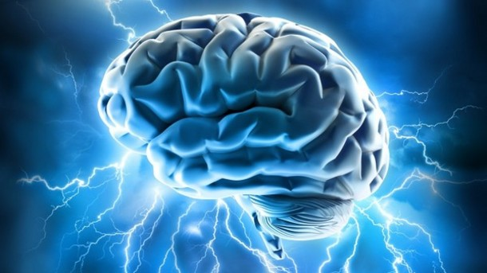
Traumatic Brain Injury
By: Brynn and Kacy

Slide 2
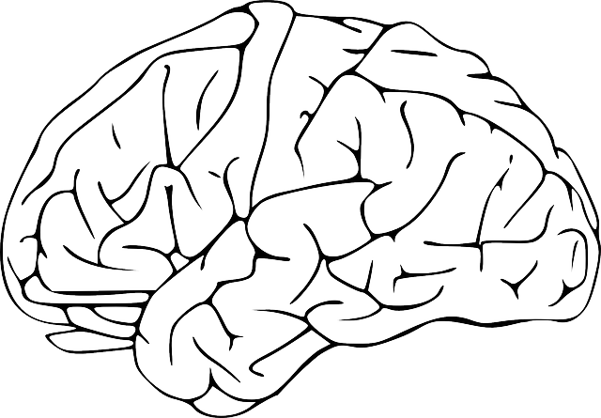
Definition
Occurs when a sudden trauma causes damage to the brain, disrupting the normal functioning of the brain.
TBI’s can occur when the head suddenly and violently hits an object, or when an object pierces the skull and enters brain tissue.

Slide 3
Notes:
https://www.youtube.com/watch?v=J08v0d7Fygg

Slide 4
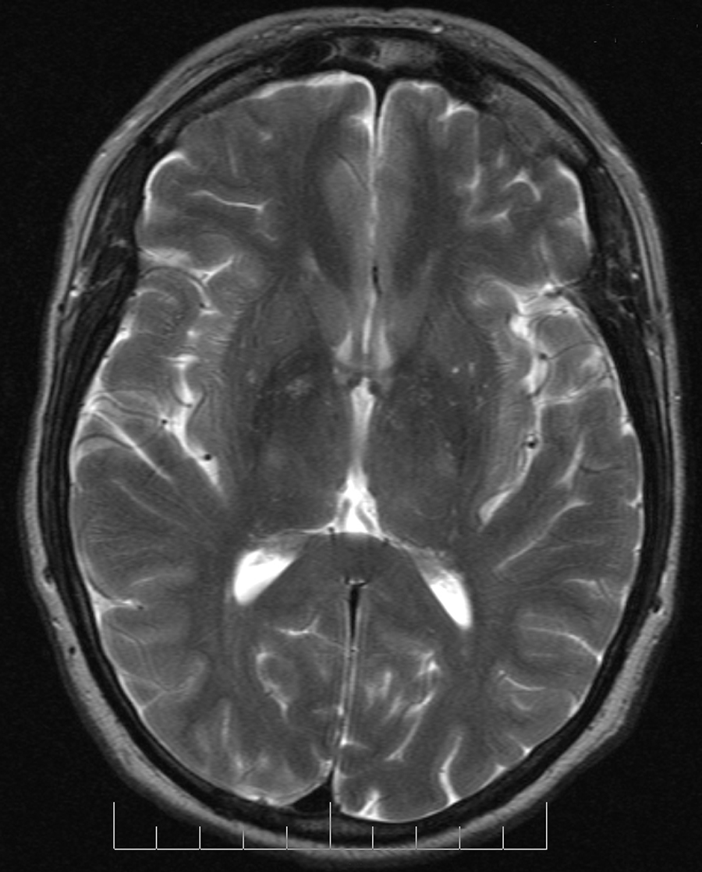
Effects and Symptoms
The effects of a brain injury can affect all aspects of our lives, including our personality
Cognitive impairment in thinking and memory skills
More pronounced behavioral issues

Slide 5
Causes
Vehicle Accidents
50% of all TBI
Firearms
Falling Down
Assault
Sports Injuries

Slide 6
Diagnosis
Glasgow Coma Scale (GCS)
a neurological scale that aims to provide a reliable objective way of recording the conscious state of a patient
Used by first aid, EMS, and doctors helping acute medical and trauma patients

Slide 7
Diagnosis
Ranchos Los Amigos Scale
a medical scale used to assess individuals after a closed head injury based on cognitive and behavioral presentations as they emerge from a coma
Brain Imaging Technology
Neuropsychological Assessments
Professional Evaluations

Slide 8
Severity of TBI’s
Mild
AKA concussion, minor head trauma, minor TBI, etc.
Characteristics include loss of consciousness and/or confusion and disorientation for less than 30 minutes
Experiences memory loss of events prior to or following the accident - does not last for more than 24 hours

Slide 9
Severity of TBI’s
Moderate
loss of consciousness and/or Post Traumatic Amnesia (PTA) for more than 30 minutes, but less than 24 hours.
Usually experience a skull fracture and long-term physical and cognitive impairments that may force patients to have very limited functional independence or even live in a vegetative state
signs and symptoms depend on location of injury

Slide 10
Severity of TBI’s
Severe
Include a loss of consciousness and/or PTA lasting 24 hours or more
Includes a coma
long-term physical and cognitive impairments that affect the patient in the same way as moderate TBI’s
Extensive rehabilitation is needed

Slide 11
Treatment
Immediate controlling of blood loss from the brain
Controlling/monitoring intracranial pressure and inflammation
Medication
diuretics, anti-seizure medication, coma-inducing medication, etc.

Slide 12
Treatment
Surgical procedures
Focus on limiting secondary damage caused by brain swelling and brain cell death that worsen after initial injury
Rehabilitation

Slide 13
Specific Needs
Adaptive technologies
wheelchairs, railings, etc.
Lots of rest
An Individualized Education Plan
Someone to drive them around
Patience
Support

Slide 14
Prognosis
Depends on how severe the injury is and the location on the brain
No cure
recovery depends on brain’s plasticity
May have complications that occur
altered consciousness Locked-In Syndrome
coma Infections
vegetative Seizures

Slide 15
TR Implications
Focuses on many aspects of the patient’s life e.g. physically, socially, intellectually, emotionally, spiritually
Increases patient’s knowledge of leisure activities
Recreation is an outlet to express oneself

Slide 16
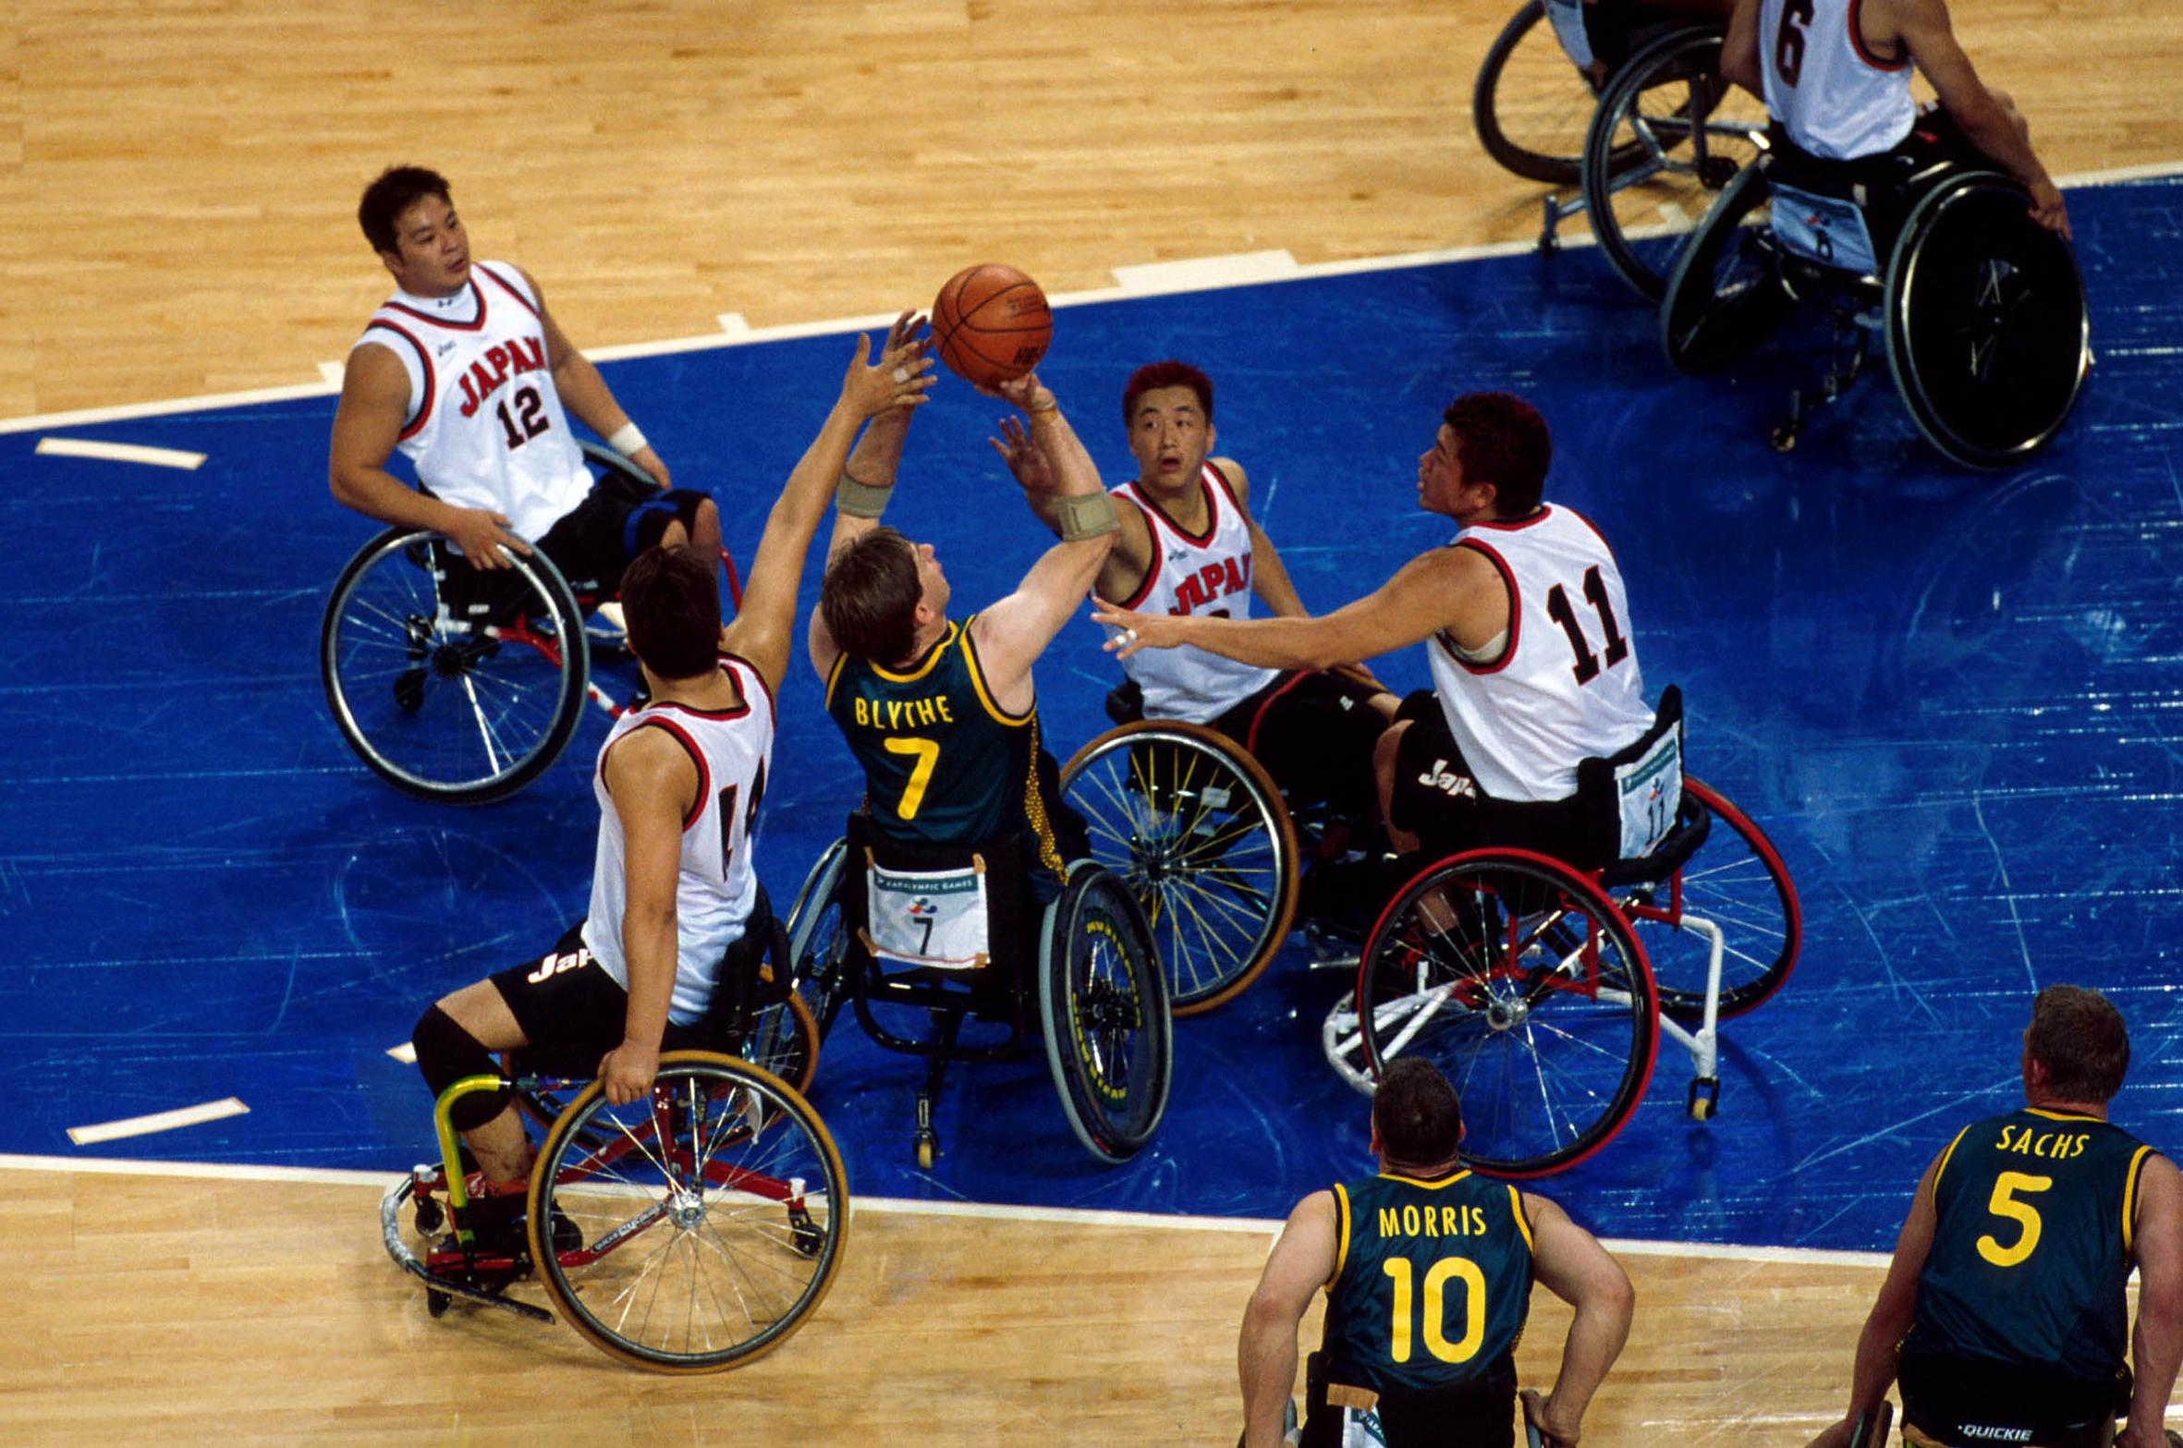
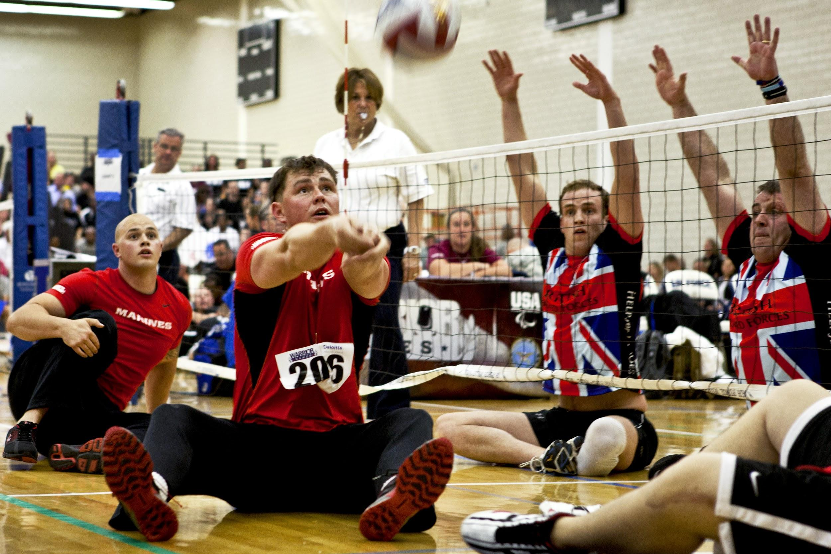
Adaptive Recreation

Slide 17
Resources
Group Homes-social support
Community Rec Centers

